Slide 1

Train Traction Motor Simulation and Control
Presenter: Mythra, IIT Guwahati
Project Title: Electric Train Traction Motor Simulation and Control Using Open-Source Tools
Problem Statement: Electric trains rely on high-torque, efficient traction motors controlled via sophisticated power electronics. This project simulates such a system using freely available open-source tools, making it ideal for academic research, education, or proof-of-concept prototyping.
Project Objective: To design, model, simulate, and analyze the performance of an electric traction motor system typically used in electric trains, focusing on a DC traction motor and its control circuitry. The aim is to utilize KiCAD for schematic design and Ngspice for circuit simulation to evaluate the dynamic behavior, speed regulation, and system response under various operating, load, and fault conditions.

Slide 2
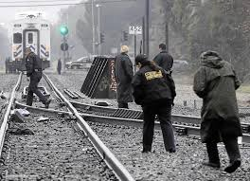
Background & Context
The Challenge of Electric Traction Systems
Safety Demands Absolute Stops: Electric trains require reliable control, especially achieving absolute zero speed in emergencies. This is critical for preventing severe accidents, like those related to suicides on tracks, ensuring passenger and public safety.

Slide 3
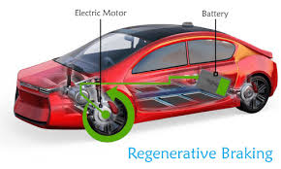
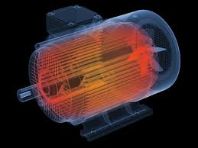
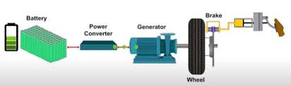
Background & Context
The Challenge of Electric Traction Systems
Efficiency Drives Energy Recovery: Traditional train braking wastes massive kinetic energy as heat. There's a vital need for solutions that actively
recover this energy through methods like regenerative braking, boosting overall system efficiency and reducing operational costs.
Reliability Under Stress: Trains must perform robustly under demanding conditions. This includes handling varying gradient slopes and preventing issues like frequent overheating and motor wear during sudden speed drops or climbing gradients.

Slide 4
Literature/Market Research
Addressing the Simulation Landscape Gap
Existing Solutions & Their Limitations:
High-fidelity simulation for traction motor systems commonly relies on expensive, proprietary software suites. These industry-standard tools, such as MATLAB/Simulink (with Simscape Electrical), LTSpice, PSpice, ANSYS Maxwell, or PLECS, offer extensive component libraries, advanced features, and dedicated technical support.
However, their significant licensing costs often limit accessibility for academic research, educational initiatives, or rapid proof-of-concept prototyping without substantial institutional investment.
Research & Market Gap Identification:
Our research involved understanding the current methodologies and tools employed in both industrial and academic settings for traction motor simulation.
This revealed a notable
market gap: a demand for powerful, yet accessible and low-cost, simulation tools capable of highly detailed component-level simulation, particularly for intricate fault modeling and analysis.
The Problem Statement itself emphasizes the use of "freely available open-source tools" as ideal for "academic research, education, or proof-of-concept prototyping"
Our Insight & Solution (Open-Source Power):
Our insight is that utilizing
KiCAD for schematic design and Ngspice for circuit simulation directly addresses this identified gap.
These open-source platforms demonstrate that complex tasks, including multi-layered fault simulation and detailed fault-to-damage mapping (e.g., current overshoot leading to thermal stress and irreversible motor failure), are achievable with low-cost, accessible tools, challenging the perception that only proprietary software can handle such complexity. This showcases a unique, open-source driven approach.

Slide 5
Proposed Solution
Innovative & Comprehensive Traction System Solution
Core Integrated Control Platform: Our solution provides a holistic simulation platform for DC traction motors, integrating a high-efficiency buck converter for precise speed control with an advanced PID regulator. This platform is designed for dynamic response under varying loads and operating conditions.
Multi-layered Fault Simulation with Damage Mapping (Unique & Innovative):
Beyond simple ON/OFF behaviors, our system simulates
gradual loading, sudden fault injection, and detailed component-level responses.
Crucially, we incorporate
fault-to-damage mapping. This models the physiochemical interpretation, for instance, how a current overshoot can lead to thermal stress, insulation aging, and ultimately irreversible motor failure. This provides deeper insights into failure modes than conventional simulations.
Advanced Energy Management Systems (Innovative & Highly Relevant):
Regenerative Braking: An active system recovers the motor's kinetic energy during deceleration. This recovered back EMF is efficiently stored in a capacitor bank, significantly boosting overall system energy efficiency.
Thermoelectric Generator (TEG): Uniquely, our solution integrates a TEG to capture waste heat from components (e.g., motor, switching losses) and convert it into usable electrical energy, further enhancing efficiency and demonstrating sustainable design principles.
To rigorously test our system's resilience, we implemented targeted fault injection snippets within the Ngspice netlist. This allows us to actively simulate 'train stress conditions' beyond simple load changes. We generate overcurrent and motor stall faults by programmatically modifying the V_LOAD_PROFILE to simulate sudden, extreme gradients. Overtemperature faults can be injected by temporarily forcing the TEMP_NODE higher. We also simulate critical PWM stuck faults by overriding the PWM_OUT_NODE with a forced low or high state. Furthermore, we inject insulation damage by accelerating temperature stress in the E_INS_STRESS model. This multi-layered fault injection methodology directly supports our unique fault-to-damage mapping analysis, validating the system's ability to detect and respond to diverse failure modes.
Open-Source Driven & Scalable Methodology (Originality):
Our entire solution is developed using
only KiCAD and Ngspice , challenging the notion that complex fault modeling requires expensive, proprietary software. This showcases how low-cost, open-source tools can tackle intricate industrial simulation problems.
The modular and parameter-driven design ensures high
reusability, allowing the simulation to be reconfigured for diverse load conditions, voltages, control algorithms, and various electric mobility platforms.

Slide 6

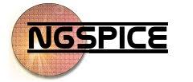
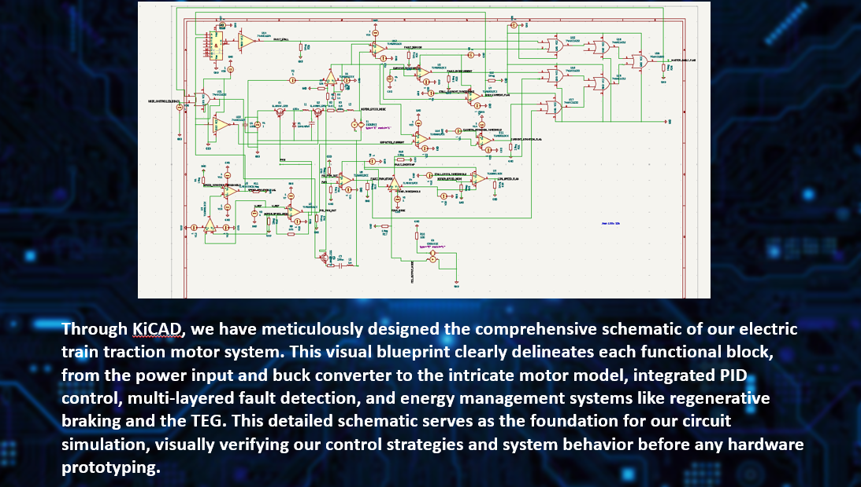
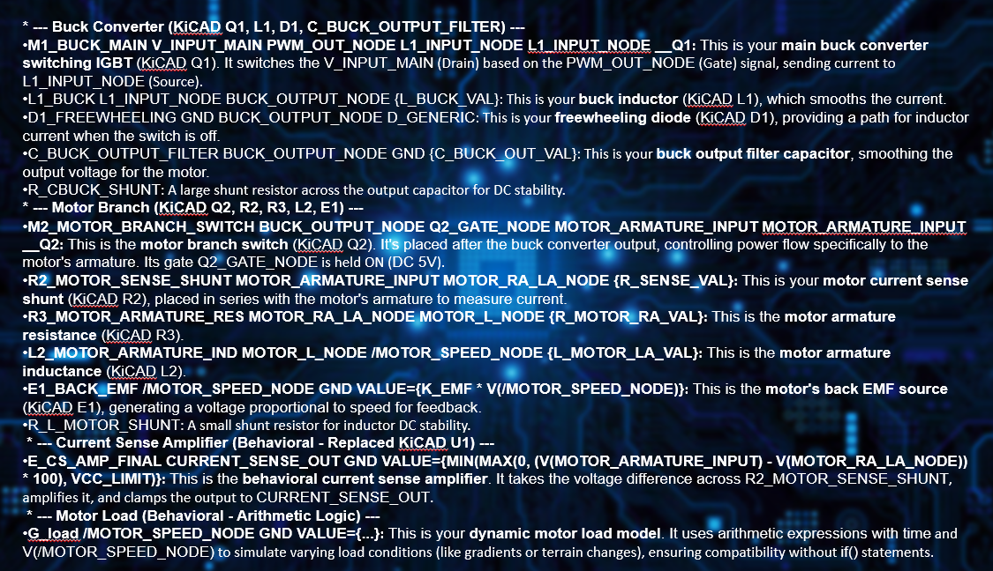
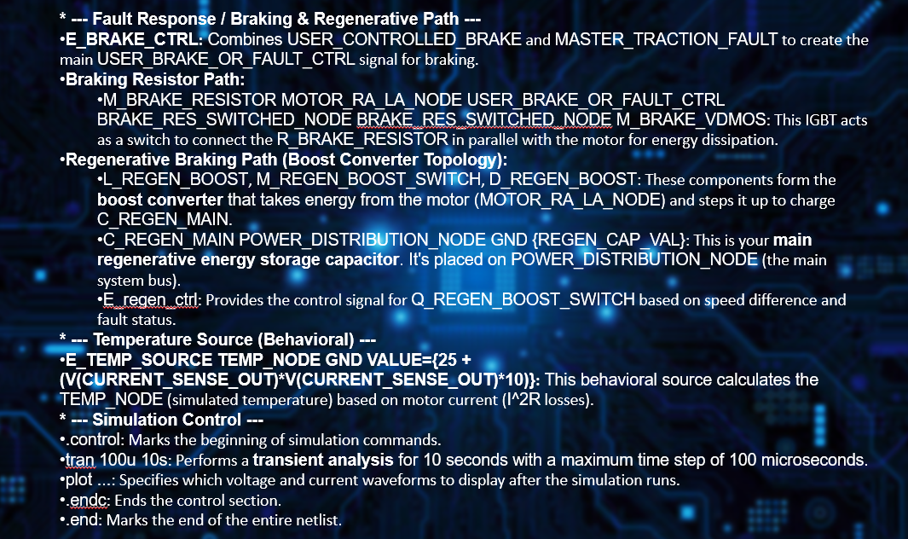
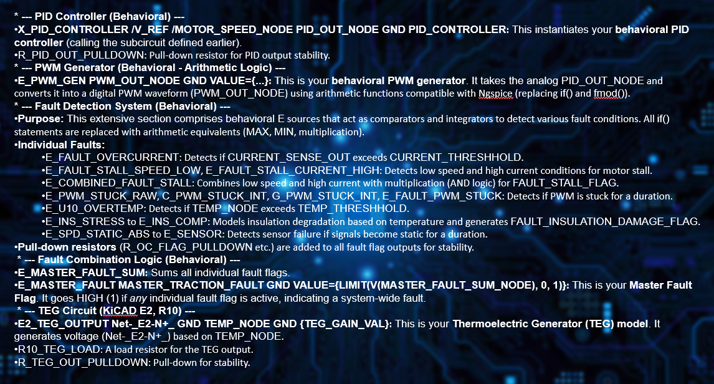
Technical Approach: From Schematic to Simulation
Technical Approach
Our design methodology follows a systematic, iterative process to model and simulate the complex traction motor system. We leveraged
KiCAD for meticulous schematic design, visually representing each functional block and its interconnections. This visual blueprint then served as the foundation for our
Ngspice circuit simulation. For each key segment of our design, we will now detail its construction within KiCAD, explain its precise function, and illustrate how its complex behavior is implemented through powerful Ngspice code, enabling comprehensive dynamic analysis and fault condition evaluation.

Slide 7
Tools, Technologies, & Collaborative Learning
Core Software Ecosystem:
KiCAD: Utilized for comprehensive schematic capture and circuit design. Its open-source nature provided an accessible and powerful platform for visually constructing the system.
Ngspice: Employed as the primary circuit simulator for analyzing dynamic behavior, transient responses, and complex component interactions.
VS Code: Used for meticulous netlist editing, enabling precise integration of behavioral models and custom logic.
Training & Iterative Learning:
The project necessitated intensive
self-training on Ngspice's advanced behavioral modeling, including This was a highly iterative learning process, adapting design and simulation techniques to meet project objectives.
Problem-Solving & Support:
The journey involved immense troubleshooting, overcoming numerous syntax errors, 'singular matrix' issues, and behavioral function incompatibilities Leveraged collaborative support and guidance from learning coaches and problem-solving methodologies, which proved instrumental in iteratively refining the netlist and resolving complex simulation blockers.
This process directly enhanced systems thinking, attention to detail, and resilience under iterative testing.
Value Added:
Enabled the execution of a complex, industry-relevant project using low-cost, open-source tools.
Provided deep practical insights into power electronics design, control system integration, and robust fault management.
Demonstrated the effectiveness of iterative debugging and analytical problem-solving in challenging engineering contexts.

Slide 8
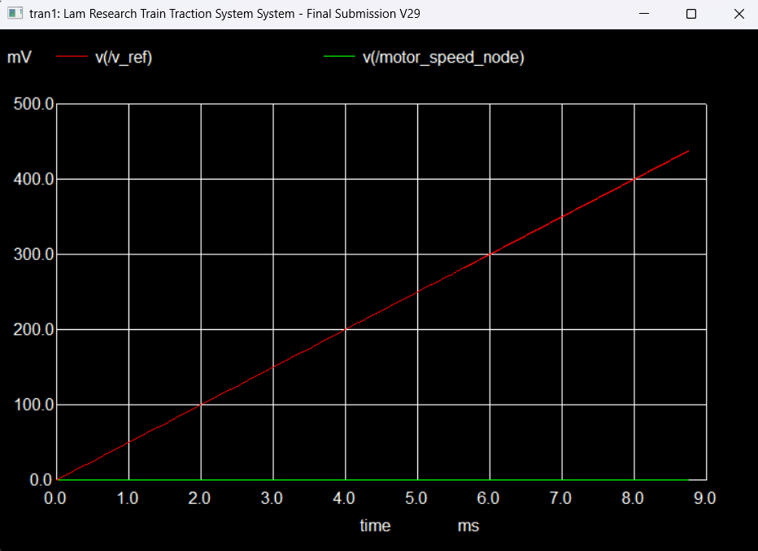
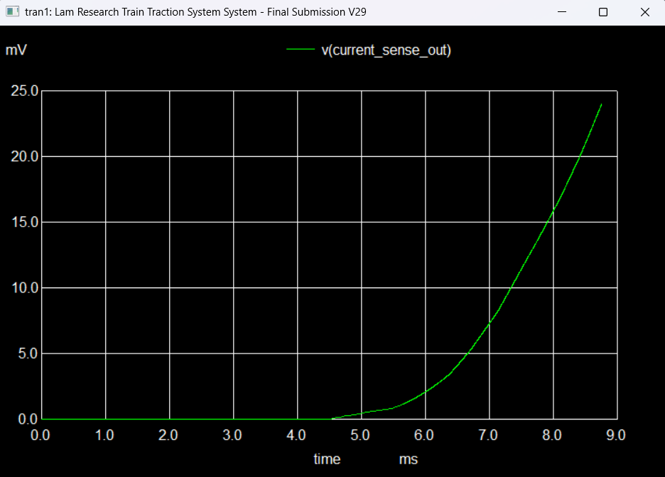
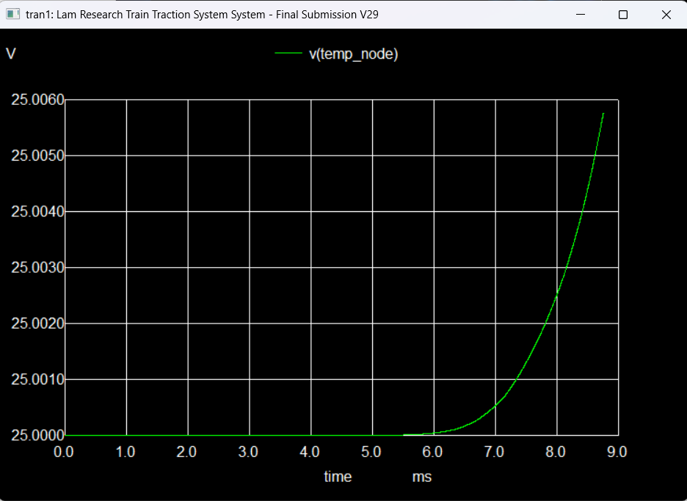
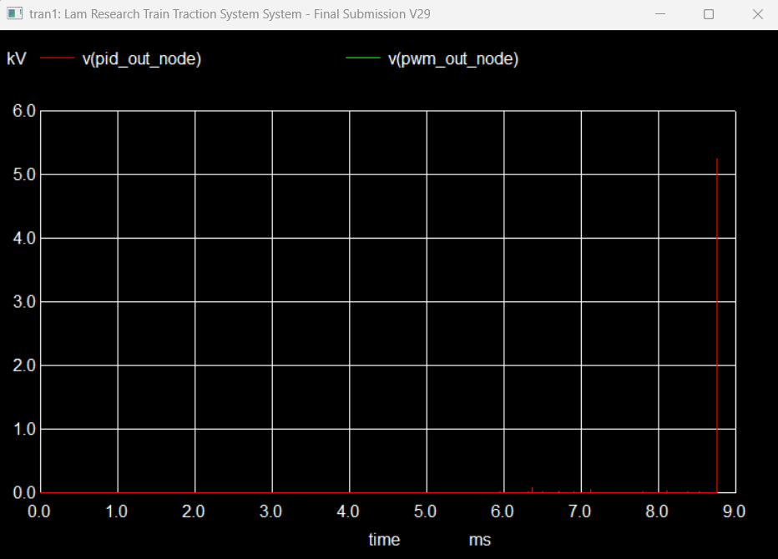
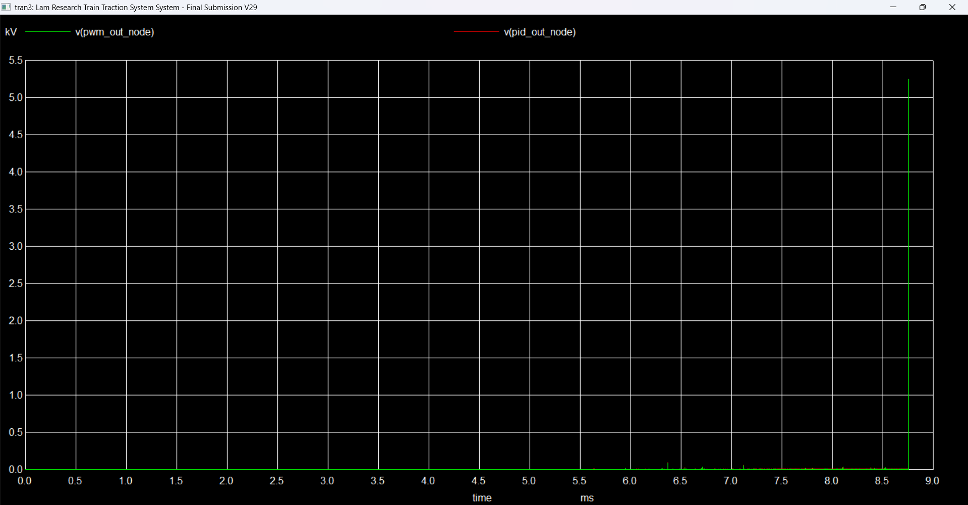
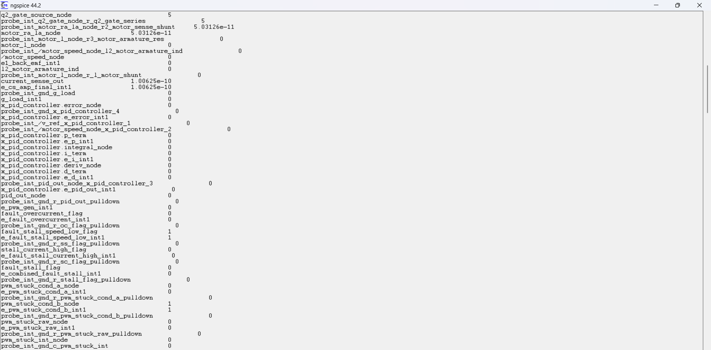
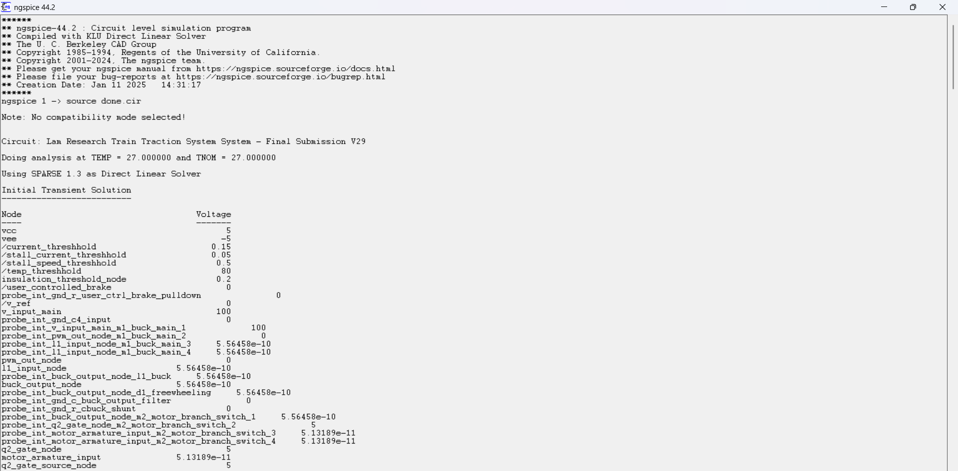
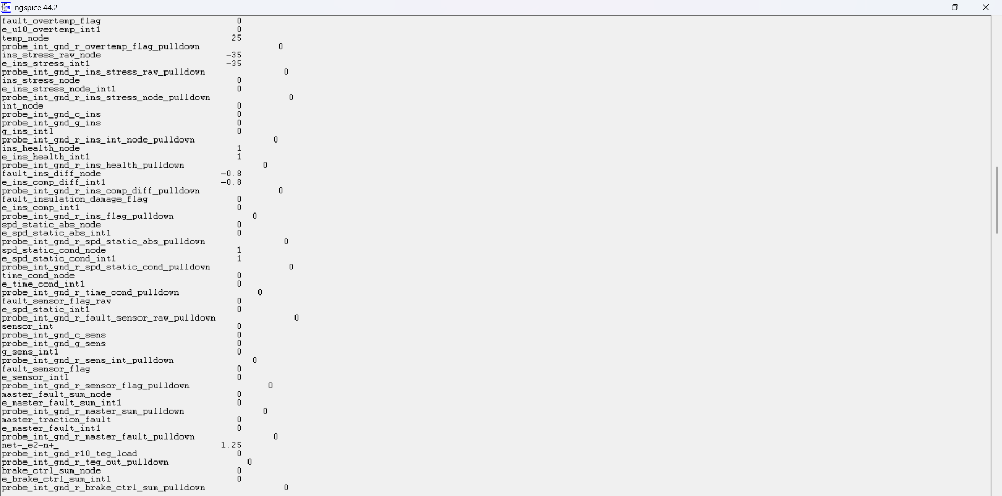
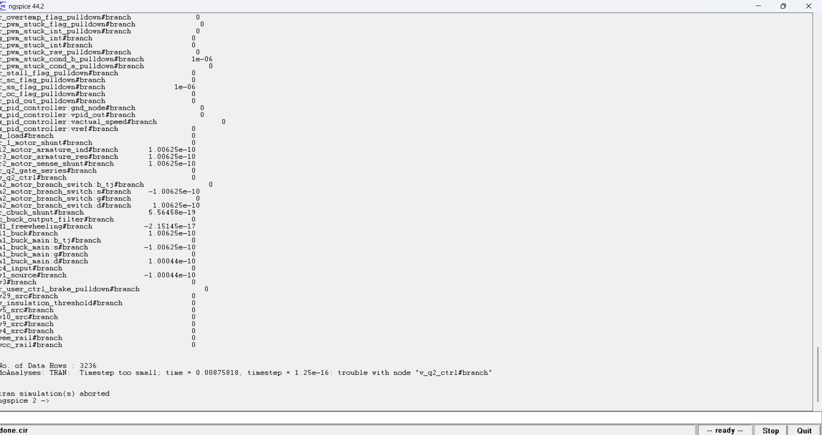
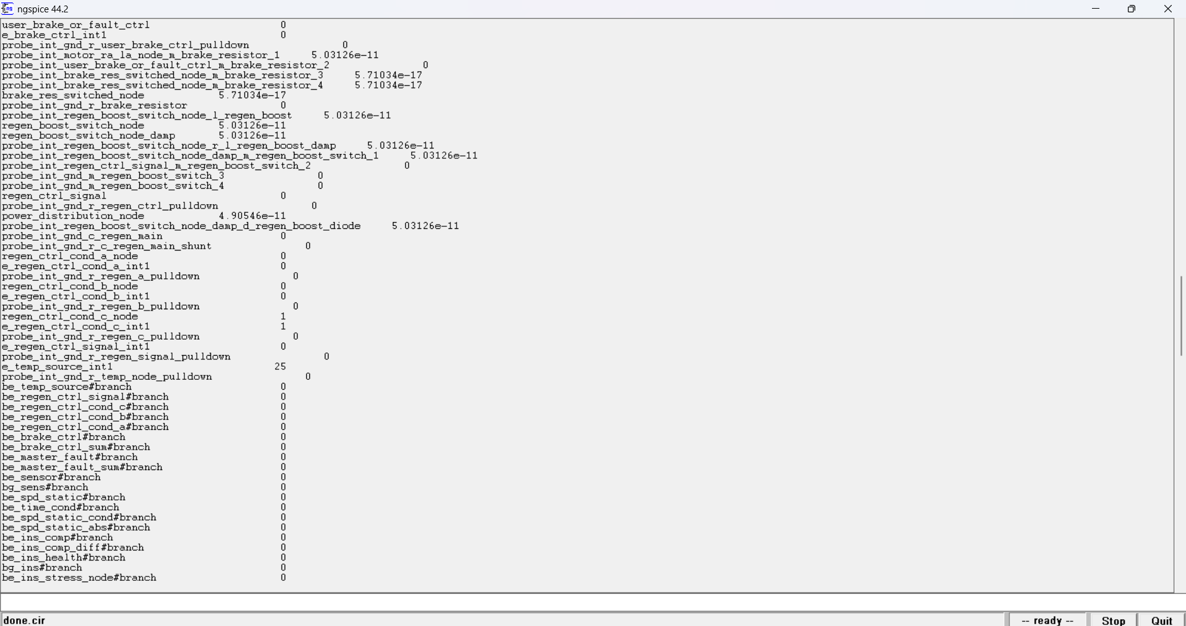
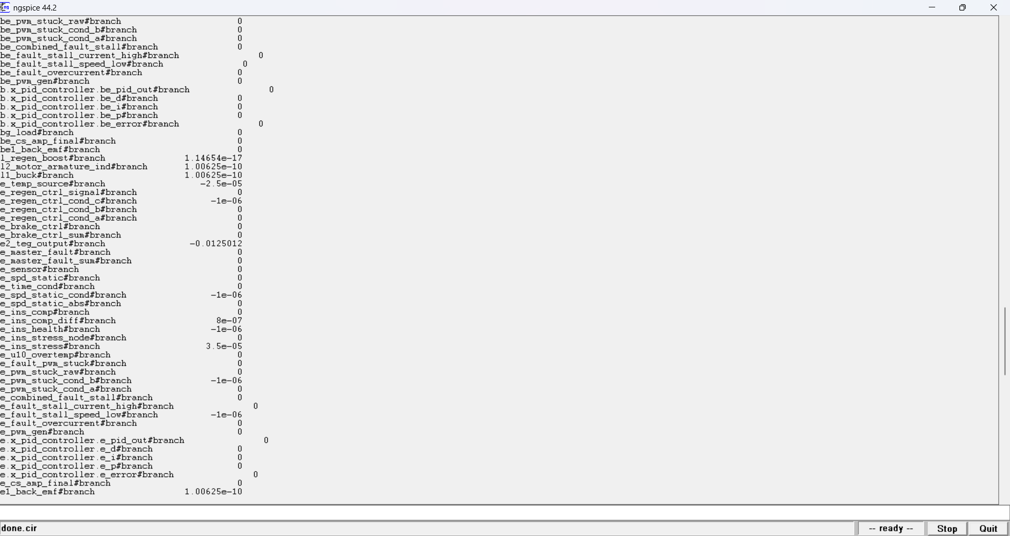

Slide 9
Scalability & Future Impact
High Reusability & Scalability: The modular design of this simulation allows it to be easily reconfigured for various load conditions, different input voltages, and alternative control algorithms. This makes it highly scalable for diverse electric mobility platforms, extending its applicability beyond just suburban trains.
Component-Wise Improvements & Refinements:
Power Switches (IGBTs): Integrate manufacturers' specific SPICE models for higher accuracy in switching losses and thermal analysis; explore adding snubber circuits for transient suppression.
Passive Components (L, C, R): Incorporate non-ideal models (e.g., ESR for capacitors, DCR for inductors) to refine efficiency predictions and transient behavior.
Sensors: Model sensor noise, drift, and calibration errors; investigate multi-sensor fusion for enhanced fault detection.
Control Algorithms: Implement advanced or adaptive PID tuning methods, or explore model predictive control for optimal performance.
Motor Model: Expand the mechanical load model to include more complex factors like aerodynamic drag and dynamic inertia changes.
Energy Management: Develop more detailed thermal models for TEG input; optimize regenerative braking efficiency across a wider speed range.
Documentation & Proof of Concept: Meticulous documentation, including the Unique Document, provides a strong foundation and serves as a vital proof of concept for the developed system.
Publication Potential: The work demonstrates a unique approach to complex fault modeling using only KiCAD and Ngspice, showcasing how low-cost, open-source tools can handle intricate simulation challenges. This innovative methodology presents significant potential for academic publication and further research in power electronics and control systems.

Slide 10
A Resilient Path to Comprehensive Simulation
The Journey: Debugging & Optimization as Core Learnings:
The path to this functional simulation was marked by an intensive iterative debugging process. We systematically addressed numerous challenges:
Initial
Ngspice parsing errors (e.g., if() function incompatibilities, 'Not enough tokens') were resolved by meticulously converting complex logical expressions into robust arithmetic equivalents.
Persistent
'singular matrix' errors were tackled through strategic pull-down resistors and careful re-evaluation of node connections for DC stability.
Model definition mismatches and parameter initialization issues were meticulously identified and corrected, reinforcing attention to detail.
The power path topology (buck, motor, braking, regenerative) underwent extensive re-wiring and logical refinement in the netlist to accurately reflect component roles, moving from initial conceptual designs to a precise, runnable model.
Every error became an opportunity for optimization, leading to more stable, reliable, and efficient code. This process was a masterclass in resilience, attention to detail, and problem-solving methodology.
Learning Outcomes & Future Vision:
This project provided profound insights into power electronics design, advanced control system integration, and building highly
reusable and scalable fault-tolerant systems.
We proved that accessible tools can deliver sophisticated results, laying a strong foundation for future research and
publication potential.
Project Summary & Key Achievements:
We successfully designed and simulated a
comprehensive electric train traction motor system, encompassing power electronics, advanced control, multi-layered fault detection, and intelligent energy management.
Our unique solution includes
component-level fault simulation with fault-to-damage mapping and integrates a Thermoelectric Generator (TEG) for waste heat recovery.
This entire system was realized using only
open-source tools, KiCAD for schematic design and Ngspice for simulation, demonstrating their powerful capabilities for complex industrial problems

